Slide 1
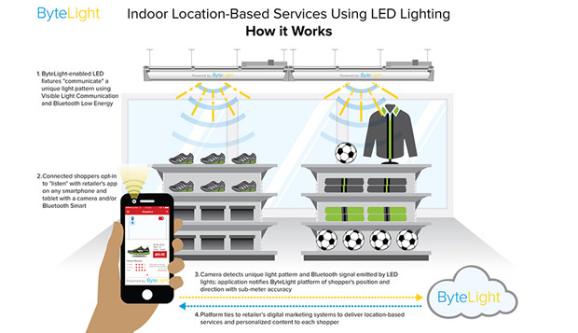
SpinLight: A high accuracy and robust light positioning system for indoor applications
Bo Xie, SIAT
Guang Tan, SIAT
Tian He, UMN
SenSys 15’
Notes:
1. Spinlight, 一种搞精度和鲁棒性的光定位系统，室内定位应用

Slide 2

Why to select this one from papers?
1. Edge computing
device(mcu, eg. stm32)
2. light position, research basis
wang zhe
3. light position and SLAM
related with simultaneous localization and mapping
4. commercial value
bytelight
Notes:
选论文的原因，
1.边缘计算
2.光定位的研究基础
3.光定位和SLAM
4.bytelight商业应用

Slide 3
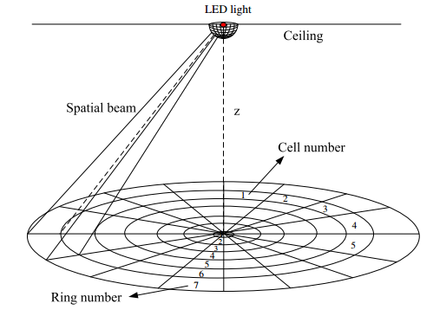
Abstract
Notes:
系统的基本架构

Slide 4
Abstract
1.Spinlight
an indoor positioning system
infrared LED lamps as signal transmitters, light sensors as receivers.
2.Idea
divide the space into spatial beams originating from light source
identify each beam with a unique time sequence of light signals
3.Sequence
a coded shade that cover and rotates around LED.
blocking or allowing light to pass through according to predefined pattern
4.receiver ( light sensor)
determine spatial beam by detecting light signal,
followed by optimization schemes to refine its location within that beam.
5.2D/3D localization designs
a prototype implementation.
6.Experiments
location error of 3.8 cm,
7.Low power of the receiver design
operate for months to years from a button coin battery.
Notes:
摘要
1. SpinLight，是一种室内定位系统，采用红外LED灯泡作为信号发送器，光传感器作为接收器；
2. 主要想法，将以光源为中心的空间分成光束，使用不同的独特的光时序来识别每个光速；
3. 时序，编码的光罩，围绕LED旋转；按照预先定义的模式来挡住光线和让光线通过；
4. 接收器，光传感器，通过识别光信号识别空间光束，然后在光束进一步优化；
5. 2D/3D定位设计实现；
6. 定位误差3.8厘米
7. 接收器的低功耗设计；

Slide 5
I. Introduction
II. System overview
III. 2D Localization
IV. 2D Localization:optimizations
CONTENTS
V. 3D Localization
VI. Experimental Evaluation
VII. Discussion
VIII. Related work
IX. Conclusion

Slide 6
I. Introduction
Fine-grained indoor localization can enable a multitude of applications
manufacturing
warehouse management
robot localization and navigation
healthcare application
supermarkets and shopping malls
both industry and academic community efforts
make tremendous efforts to realize inexpensive,reliable,easy-to-use location
the adoption of high accuracy indoor localition still in its infancy.
Notes:
1. 细粒度室内定位，将会带来大量应用；
制造，仓库管理、机器人定位导航、医疗康养、超市购物中心
2. 来自产业界和学术圈对于定位研究的努力

Slide 7
I. Introduction
Indoor localization using visual light communication(VLC)
compared with RF , propagation of light more predictable
allowing more reliable location estimation using geometric models.
differentise with RSS-based model and AoA approach
the goal s of a New approach to light-based localization
robustness against light noise and ambient interference
insensitivity to receiver orientation
low energy consumption of location sensing, important to small-sized tags
Notes:
1. 使用可见光通信的室内定位
相比无线通信技术，光的传播更有预测性
使用几何模型定位更可靠，
2. 光定位的新方法的目标
对光定位噪音和环境干扰的鲁棒性
对接收器的方向不敏感

Slide 8
I. Introduction
SpinLight
3D space is divided into spatial beams originating from transmitter(coordinates)
Each beam is identified with a unique timed sequence of infrared signals
IR no visual disturbance to human eyes
timed sequence created by a hemispherical shade that covers and rotate around the LED by step motor.
shade is divided into cells by its longitude and altitude lines, some cells are removed to allow light to pass through
rotation of shade generates uniques light patterns in different spatial beams
receiver(light sensor), determine spatial beam containing it by detecting and decoding signal pattern.
receiver perform 2D localization, assuming a known height and one transmitter
additional transmitter can be used to realize 3D localization
Notes:
介绍SpinLight
1. 3D 空间分成很多空间光束
2. 每条光束都可以被识别为一个独特的红外信号时序
3. 红外光对人眼没有视觉干扰
4. 由步进电机驱动的光罩，光罩被分为很多经纬度
5. 光罩的旋转以不同的光束产生独特的光模式

Slide 9
I. Introduction
SpinLight feature
digital-only approach
existing light positioning approaches ,RSS
digital nature , less affected by noise, interference, and multipath effect
enjoying an order of magnitude improvement in location accuracy.
insensitive to receiver orientation, critical for RSS or AoA
complicated receiver design
RFID
achieve centimeter-level accuracy
without line of light
highly dense deployment of reference tags
work for mobile objects
Notes:
1. Spinlight的特征
只有了数字方法，其他方法有光照强度，光照的角度
现成光定位方法，RSS，接收信号强度
数字特征，很少受噪音，干扰和多径效应影响
定位精度，一个数量级的改进
对于接收器的方向不敏感
复杂的接收器设计
2. RFID
厘米级精度
光线
高密度的标签
移动物体

Slide 10
I. Introduction
Contributions
propose a light positioning approach based on the idea of spatial division.
differing from RSS or AoA
robust
low power
present a series of optimization schemes
refine location results
deal with gray areas,
single transmitter , the median error is 3.6cm
two transmitter, 3D implementation
Notes:
贡献
1. 提出一种光定位的方法
不同于RSS和AoA
鲁棒性
低功耗
2. 提出一系列的优化方案
提炼定位结果
处理灰色区域
单个发送器，平均错误3.6厘米

Slide 11
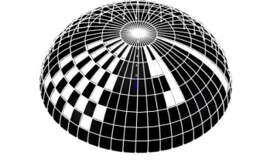
II. System overview
The transmitter contains an IR LED chip
at a few watts are quite small in size
a ponit light source
controlled by mcu to flash at specified rate, distinguish from other transmitter
Hemispherical shade
cover the LED chip
rotate horizontally around the chip at a constant speed under the drive of the step motor
be divided to shade rings and shade cells
Shade stay still
from the viewpoint of the light source
s-cell projected onto floor ,forming an area called a cell
shade ring's projection on the floor is called a ring
Shade spin around
light beam rotate, light spot on floor move like dance floor
light spot sweep across the receiver
Light sensor
detect a window of light signal,
s-ring,create s-cell differently
receiver detect different flash patterns
Notes:
系统设计
1. 发送器包括了一个红外LED芯片
几瓦，尺寸比较小
点光源
mcu控制下，以特定频率闪烁，不同与其他发送器
2 半球光罩
把LED芯片罩住
水平方向旋转，固定速度，步进电机控制
分为光罩圈s-ring和光格s-cell
3. 光罩保持静止
从光源的角度
光罩圈投射形成圈
每个光格投射到地板上,形成一个区域叫格子cell
4. 光罩旋转
光束旋转，光点移动像舞台那样，光点也会扫到接收器
5. 光传感器
识别光信号的窗口
光罩圈的光罩格不同
接收器识别不同闪烁模式

Slide 12
II. System overview
The symmetry
different cells of the same ring detect same sequence of signal
so, sequence of signal can determine the ring number
Differentiate the cells,
synchronization mechanism
mark a start point...shade' current direction
led light switch two different flash rate, signal window width estimate angular offset
Fine-tune the receiver's location in a cell
detect a signal window, length is a function ,receiver's offsets to cell's edges
estimate the relative position within a cell
the above highth is known, if the z is unkown
position ambiguity will arise
use two transmitter to create two candidate position for the receiver
the intersection is the receiver's real position
Notes:
对称性
同一个圈，可以识别到相同的信号序列
信号序列就能识别圈的number
区分格
同步机制
起始点
LED光切换两个不同闪烁频率，信号窗口宽度估计角度偏移
在一个格子内微调接收器的定位
识别信号窗口，长度是接收器对边缘偏移的函数
估计在格子内的相对位置
之前的高度已经知道，
定位的模糊性增加
使用两个发送器来定位
交叉点

Slide 13
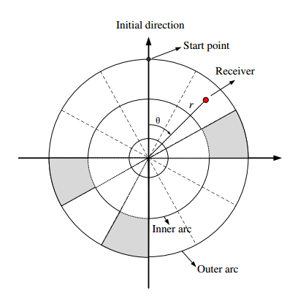
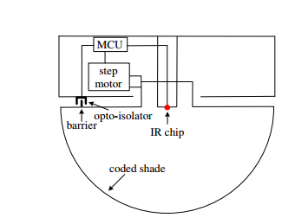
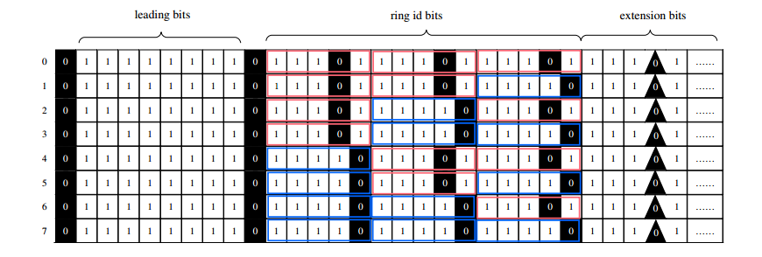
III. 2D Localization
first introduce the rotation control of shade
let receiver know when new round of shade rotation begin
calculate angle with respect to the initial direction
code design
polar grid inner arc, outer arc
structure of transmitter
control the step motor
switch on and off the light at two pre-defined frequencies
opto-isolator and barrier , start point
signal window to estimate the its angle
Shade coding and cell recognition
1 : hollow s-cell 0 : closed s-cell
the code of each s-ring comprises three parts
leading bit, ring ID bit, extension bits
Notes:
光罩的旋转控制
让接收知道新的一圈开始
计算与最初方向的角度
编码设计
极坐标格
极坐标
步进电机控制
在两个预定义频率之前开关光信号
光耦和障碍物
光罩编码和格子的识别，1，孔，0，封
每个光罩圈的编码包括三个部分，leading bits, 圈ID， 扩展位
编码
11101作为一个宏编码0， 11110:1

Slide 14
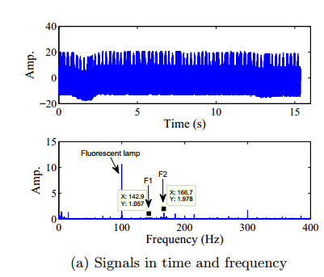
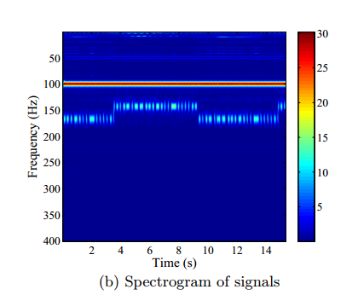
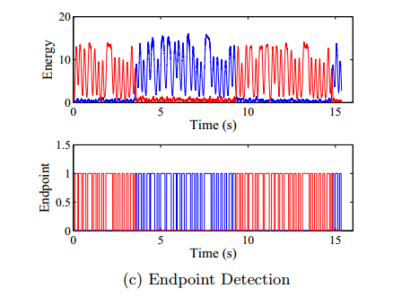
III. 2D Localization
receiver signal is a mixture of light signals from multiple source
multiple transmitters
daylight
ordinary lamps
fluctuation of the signal is due to interference from a person walking by while collecting the data
143hz and 167hz
IR at 100hz
wavelet transform signal processing tool
spectrogram of signal contains three frequency components
the longest segment of consecutive bright spots , leading bits
top level is IR from lamp
wavelet result
energy function of signal
endpoint detection
endpoint detection
like those adopted in the field of speech recognition, and normalizing the energy
Notes:
注意注意了，频率变化点到leading bit的时间间隔，计算格子的number
接收器信号的来自多源的光信号；
1. 图a主要显示接收器的信号系列和频谱分析；
2. 信号的波动主要来自于有一个人在旁边走过的干扰
3. 频谱图上，亮点用于pass through，暗点表达被遮挡
4. 三个频率部分，100hz Fluorescent lamp, F1, F2
5. 亮暗相间代表光圈的编码，最初的连续光点，代表leading bits
6. 能量函数，与机器学习中的能量函数到底什么关系
7. 归一化/normalizing the energy这是什么鬼
8. 我们可以从图c中获得ring code , 阻挡物的宽度跟1的数量成比例
9. 编码来实现ring id，第一个闪烁频率变化和leading的时间间隔作为cell number
10. 判断的格的中央作为接收器的位置

Slide 15
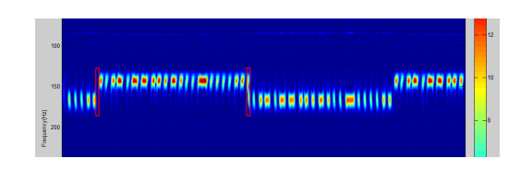
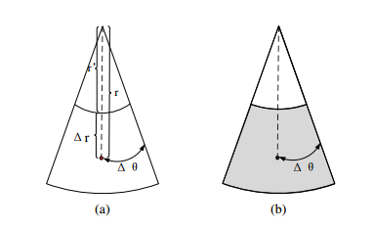
IV. 2D Localization: Optimizaions
Rough estimate of real location
improve accuracy, create highly dense s-cell on the shade
limit the size of a cell on the floor to a centimeters, a s-cell may need sub-millimeter level size
generate blurry cell edge
as a result, receiver face more uncertainty in detecting cell
at the same time, delicate construction of the shade complicate the design of the transmitter, increase the cost
So we need a software approach to refine the location result and reliablity issues
Fine-grained localization
obtain relative location to the edges of its cell
r' , the radius of its ring's inner circle; r, the receiver's radius
if the cell is 0, propose a shifted round synchronization strategy to solve the problem
ensure the cell exposed to light
two cases to deal with when determine
as fig a, a 1 cell, can see a non-integral multiple of cell peroids
as fig b, a 0 cell, the methods must be changed
Notes:
简单真实位置估计
1改善精度，在光罩上创造高密度的s-cell；
2现在底板上的cell的大小到厘米级别，s-cell就必须达到毫米级别
3.这样就会产生模糊的cell边界
4.导致接收器在检测cellde时候面临更多的不确定；
5.精巧的设计使得发送器的设计更复杂，增加了成本
更高粒度的定位
1. 获得相对与cell边界的位置
2. 內圆的半径，接收器的半径
3. 提出了一种移动圆同步策略来解决这个问题
4. 确保
5. 两个情况要处理这个角的偏移量
6. 格子周期的非整数倍
7. 确保这个0-cell暴露给光，计算的时候再做补偿

Slide 16
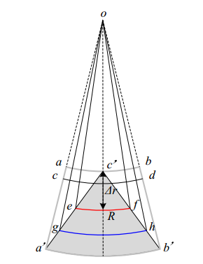
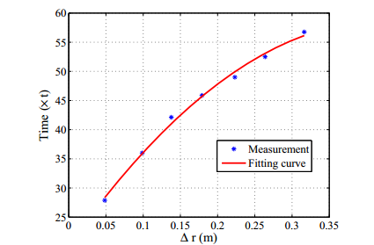
IV. 2D Localization: Optimizaions
Concrete example of estimating angular
spectrogram of signal
from blackout peroid, the receiver cannot know its relative position in cell
with our one-cell shift strategy, so the dark cell can be exposed to light
determining delta radius
propose a solution based on the idea of variable windows length
uniformity cause the ambiguity of a receiver's radial coordinate
abb'a',cell, indistinguishable to receiver on these two arcs
sub area a'b'c'
scan-arc as the intersection of this shadow area and circle
narrow tip of a triangular area may cause error radius due to gray area
Notes:
精妙之处，
由于这个得光罩的光格不可能有连续的blackout区域，如果遇到s-cell是0的话，我们就平移一下这个区域，
下一次就一定能暴露给光信号

Slide 17
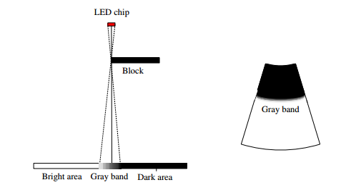
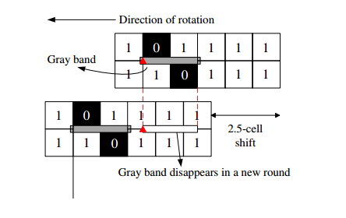
IV. 2D Localization: Optimizaions
Dealing with gray areas
a point source of light, this is not the case
create gray bands between cells
gray bands is an area with continuously decreasing gray degree from full darkness to full brightness
gray band
occur between cells within the same ring or cross two neighboring rings, with width much smaller than a cell's side length
Notes:
1. 怎么处理灰色区域

Slide 18
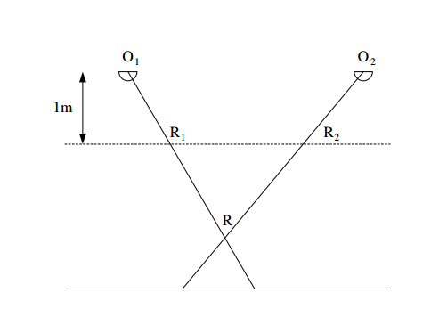
V. 3D Localization
Assuming a known height of the receiver, and obtained a 2D location.
useful for robot navigation, object tracking on fixed height carrier.
3D spatial beam generated by cell on the lamp shade, receiver detect same flash pattern
an example， its location by finding two candidate points R1 and R2, creating two rays O1R1 and O1R2
whose intersection gives the receiver's location
Notes:
1. 假定一个已知的接收器高度，获得2D定位，
2. 在固定的高度载体，对于机器人导航，目标跟随；
3. 在灯泡的光罩上的孔产生3D空间光束，接收器检测到相同的闪烁模式；
4. 通过找到R1和R2的，产生的两条光速，来实现定位；
5. 这样的交叉来给出接收器的定位；

Slide 19
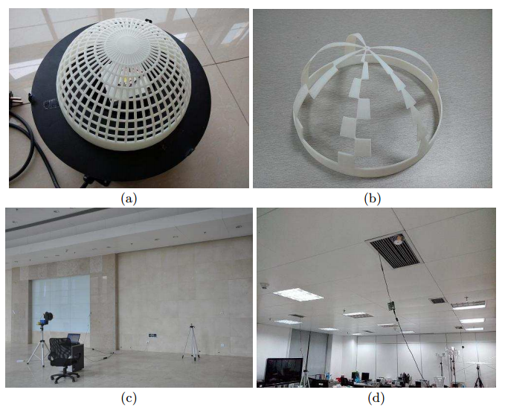
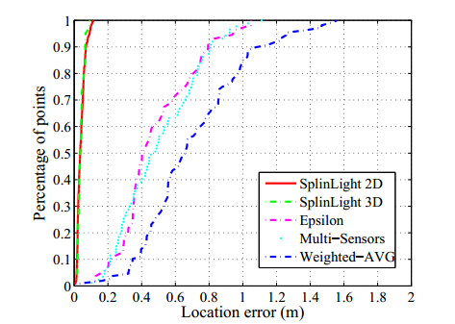
VI. Experimental evaluation
The transmitter containing an LED chip of 3W covered by a 3D printed shade whose hollow cell
The used code of the shade follows figure 5
let transmitter face a wall at a distance of 2.8m
The receiver comprise
mcu
Intersil ISL29023
used in smartphones such as the Motorola XT882
Compare five methods of light localization
Notes:
1. 发送器包括一个3w的led芯片，3d打印的光罩
光罩编码，让发送器面对一面墙，距离在2.8米
2. 接收器包括，
单片机，光接收器，或者使用智能手机
3. 定位误差小的位置点的比例越高

Slide 20
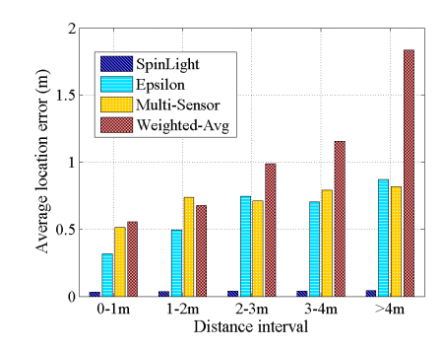
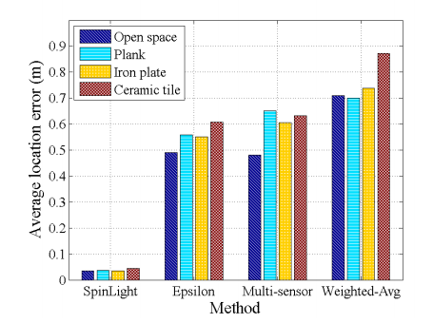
VI. Experimental evaluation
Effect of distance
give some statistics of the errors

Slide 21
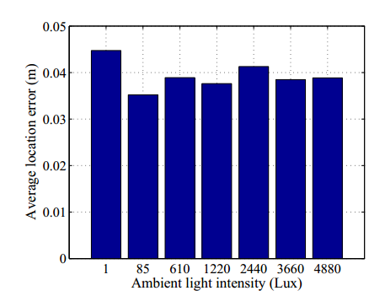
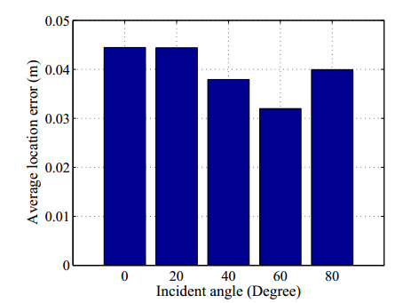
VI. Experimental evaluation
Effect of ambient light, receiver orientation

Slide 22
VII. Discussion
Deployment issues and usability
LED light with only 3W power rate
cover an erea of around 95m2
obviates the need for dense deployment of transmitters
targets both smartphone users and passive objects localization in LOS scenarios
smartphone front-facing light sensor, used for localization
operating system doesnot allow the application to sample light signals fast enough
Localization delay
shade donot rotate at high speed due to the constraint of step motor
so we can use the household electric fans, a few thousand revolutions per minutes
light sensor's sample rate between around 50hz to 40khz
Energy consumption of receiver
0.25mW
three oders of magnitude lower than CMOS image sensor
two orders of magnitude lower than BLE
Notes:
部署问题和使用

Slide 23
VIII. Related work
RF based schemes
A large class of localization techniques are based on RF including wifi, cellular radio, FM radio, magnetism ,ultrasound
used property of RF is RSS, not the stable estimator for distance or location, because of indoor multipath reflections and shadowing
propagation model or fingerprint based, low to medium accuracy, a few meter
AoA
antenna arrays are used to track RF phase to achieve sub-meter accuracy
RFID, both AoA and synthetic aperture radar approach
PinIt

Slide 24
VIIII. Conclusion
Presented Spinlight
a light based localization system for indoor environment
main innovation
its use of a rotaing lamp shade to realized spatial division and coding for environment
by detecting the flash pattern of the light signal, receiver is able to identify the spatial beam
optimization techiniques to refine its location to a few centimeters
Compared with other light positioning systems
take advantage of being less sensitive to environmental conditions and receiver orientation
low power consumption
Application
robot navigation and product assembly line
Future work
The transmitter involve a revolving shade,instability or increase error after long periods of operation
investigate the impact of mechanical vibration on location accuracy
improve algorithm to tolerate instability
more careful signal processing for a smaller localization delay for realtime positioning

Slide 25
2018
THANK YOU

